Slide 1



SRI KRISHNA COLLEGE OF ENGINEERING AND TECHNOLOGY
Kuniamuthur, Coimbatore, Tamilnadu, India
An Autonomous Institution, Affiliated to Anna University,
Accredited by NAAC with “A” Grade & Accredited by NBA (CSE, ECE, IT, MECH ,EEE, CIVIL& MCT)
Topic : Linked List
www.skcet.ac.in

Slide 2
Abstract Data Types (ADTs) – List ADT – Array based implementation – Linked list implementation – Singly linked lists – Circularly linked lists – Doubly linked lists – Application of lists – Polynomial Manipulation. Stack ADT – Operations – Applications – Evaluating arithmetic expressions – Conversion of Infix to postfix expression – Queue ADT – Operations – Circular Queue – Priority Queue – Applications of queues.
MODULE II

Slide 3
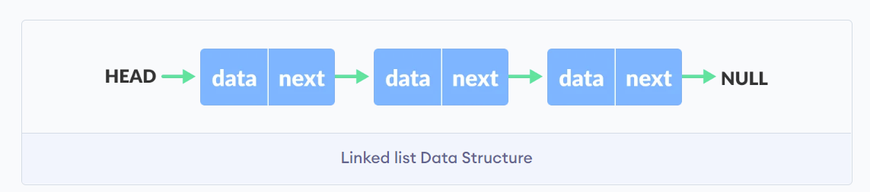
Linked List
Linked list is a dynamic data structure which is an ordered collection of homogeneous data elements called nodes, in which each element contains two parts: data or Info and one or more links. The data holds the application data to be processed.

Slide 4
struct node
{
int data;
struct node *next;
};
Structure

Slide 5
/* Initialize nodes */
struct node *head;
struct node *one = NULL;
struct node *two = NULL;
struct node *three = NULL;
/* Allocate memory */
one = malloc(sizeof(struct node));
two = malloc(sizeof(struct node));
three = malloc(sizeof(struct node));

Slide 6
/* Assign data values */
one->data = 1;
two->data = 2;
three->data=3;
/* Connect nodes */
one->next = two;
two->next = three;
three->next = NULL;
/* Save address of first node in head */ head = one;

Slide 7


Slide 8
// Linked list implementation in C
#include <stdio.h>
#include <stdlib.h>
// Creating a node
struct node {
int value;
struct node *next;
};
// print the linked list value
void printLinkedlist(struct node *p) {
while (p != NULL) {
printf("%d ", p->value);
p = p->next;
}
}

Slide 9
int main() {
// Initialize nodes
struct node *head;
struct node *one = NULL;
struct node *two = NULL;
struct node *three = NULL;
// Allocate memory
one = malloc(sizeof(struct node));
two = malloc(sizeof(struct node));
three = malloc(sizeof(struct node));
// Assign value values
one->value = 1;
two->value = 2;
three->value = 3;
// Connect nodes
one->next = two;
two->next = three;
three->next = NULL;
// printing node-value
head = one;
printLinkedlist(head);
}

Slide 10
Linked list operations
Traversal - access each element of the linked list
Insertion - adds a new element to the linked list
Deletion - removes the existing elements
Search - find a node in the linked list
Sort - sort the nodes of the linked list

Slide 11
Traverse a Linked List
keep moving the temp node to the next one and display its contents.
When temp is NULL, reached the end of the linked list so we get out of the while loop.
struct node *temp = head;
printf("\n\nList elements are - \n");
while(temp != NULL)
{
printf("%d --->",temp->data);
temp = temp->next;
}

Slide 12
Insert Elements to a Linked List
You can add elements to either the beginning, middle or end of the linked list.
1. Insert at the beginning
Allocate memory for new node
Store data
Change next of new node to point to head
Change head to point to recently created node

Slide 13
Insert Elements to a Linked List
struct node *newNode;
newNode = malloc(sizeof(struct node));
newNode->data = 4;
newNode->next = head;
head = newNode;

Slide 14
Insert at the End
Allocate memory for new node
Store data
Traverse to last node
Change next of last node to recently created node

Slide 15
Insert at the End
struct node *newNode;
newNode = malloc(sizeof(struct node));
newNode->data = 4;
newNode->next = NULL;
struct node *temp = head;
while(temp->next != NULL){
temp = temp->next;
}
temp->next = newNode;

Slide 16
Insert at the Middle
Allocate memory and store data for new node
Traverse to node just before the required position of new node
Change next pointers to include new node in between

Slide 17
struct node *newNode;
newNode = malloc(sizeof(struct node));
newNode->data = 4;
struct node *temp = head;
for(int i=2; i < position; i++) {
if(temp->next != NULL) {
temp = temp->next;
}
}
newNode->next = temp->next;
temp->next = newNode;

Slide 18
Delete from a Linked List
Delete either from the beginning, end or from a particular position.
1. Delete from beginning
Point head to the second node
head = head->next;

Slide 19
Delete from end
Traverse to second last element
Change its next pointer to null
struct node* temp = head;
while(temp->next->next!=NULL){
temp = temp->next;
}
temp->next = NULL;

Slide 20
Delete from middle
Traverse to element before the element to be deleted
Change next pointers to exclude the node from the chain
for(int i=2; i< position; i++) {
if(temp->next!=NULL) {
temp = temp->next;
}
}
temp->next = temp->next->next;

Slide 21
Search an Element on a Linked List
Search an element on a linked list using a loop using the following steps. We are finding item on a linked list.
Make head as the current node.
Run a loop until the current node is NULL because the last element points to NULL.
In each iteration, check if the key of the node is equal to item. If it the key matches the item, return true otherwise return false.

Slide 22
// Search a node
bool searchNode(struct Node** head_ref, int key) {
struct Node* current = *head_ref;
while (current != NULL) {
if (current->data == key) return true;
current = current->next;
}
return false;
}

Slide 23
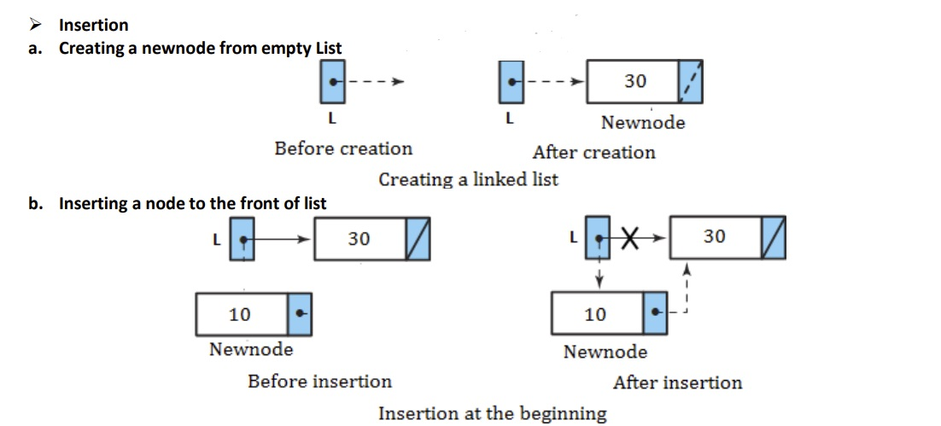

Slide 24
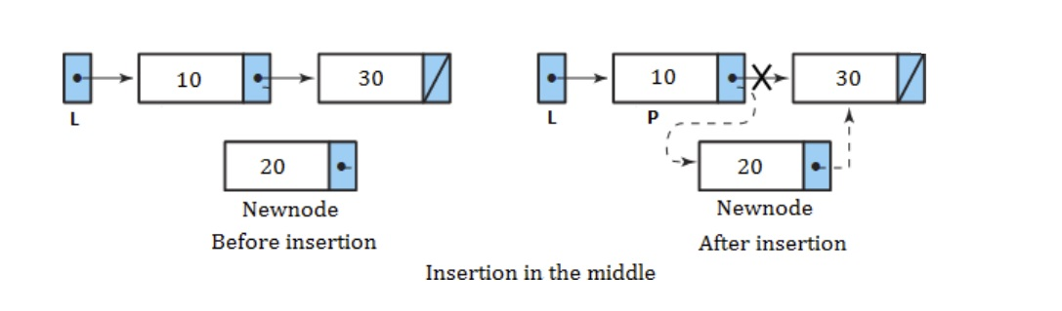
Inserting a node in the middle

Slide 25
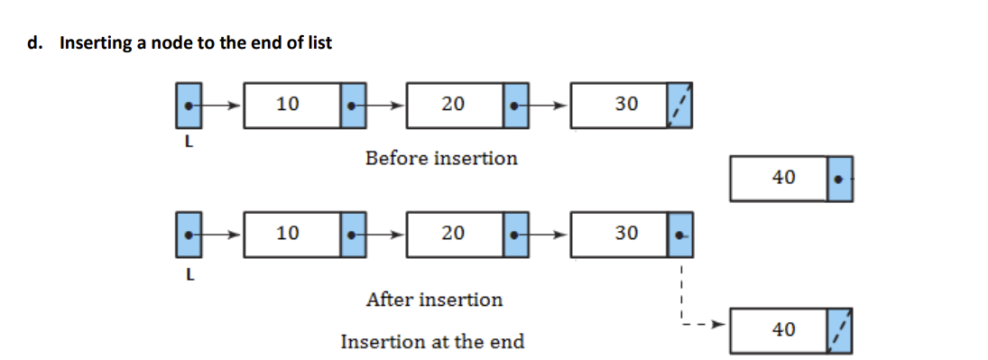

Slide 26
